Slide 1

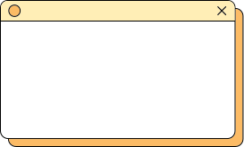


Prachi Shoree - E23CSEU0610
Tailor-Your Personalized Email Generator

Slide 2
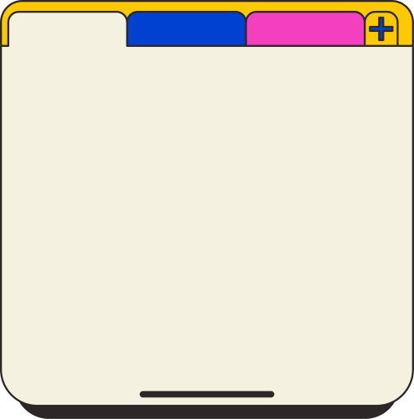
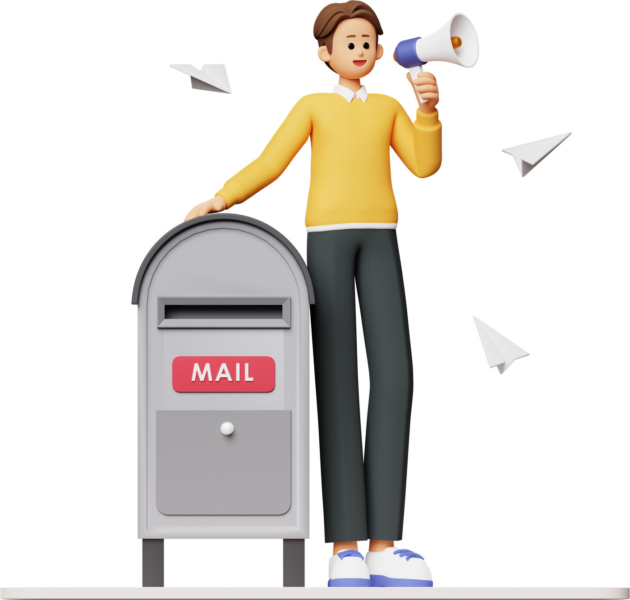
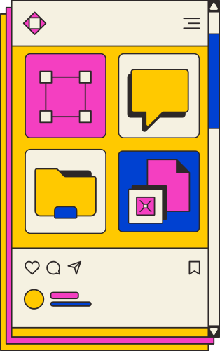
Tailor
Problem Statement
In schools, universities, and companies, there is a growing need to send personalized emails to different individuals, tailored to their specific needs and past interactions. Existing methods, often relying on static templates or limited segmentation, result in generic, impersonal communication. Crafting truly individualized emails, based on unique bios and past conversations, is time-consuming and inefficient on a large scale, leading to lower engagement and response rates.

Slide 3

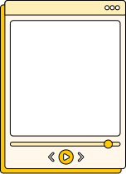
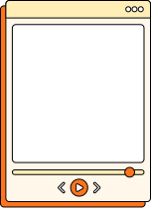

Key Challenges
Tailor
1.
2.
3.
4.
HIGH MANUAL EFFORT
STATIC, REPETITIVE COMMUNICATION
LOW ENGAGEMENT
SCALABILITY ISSUES
Crafting unique emails for each recipient requires extensive manual input and time.
Recipients are less likely to respond to one-size-fits-all messages lacking relevance to their specific profile or history.
Limited personalization makes emails feel generic, reducing their impact.
As the number of recipients grows, maintaining consistent, personalized communication becomes increasingly difficult and resource-intensive.

Slide 4

Tailor
Aims & Objectives
Automate Personalized Content Generation: Implement an NLP-driven system that dynamically customizes email content based on unique recipient bios, conversation history, and specific needs.
Seamlessly Integrate Email Dispatch: Design an integrated workflow that both generates and automatically sends personalized emails, saving time and reducing manual effort.
Enhance Engagement and Relevance: Improve engagement rates by ensuring each recipient receives emails that are relevant, context-sensitive, and customized to their personal profile and past interactions.
Enable Scalability for Large Audiences: Create a scalable solution that maintains consistent personalization, regardless of the audience size, ensuring efficiency even as recipient numbers grow.
Improve Communication Efficiency: Reduce time and resources spent on manual email personalization, allowing organizations to focus on strategic communication while Tailor handles automated customization.

Slide 5

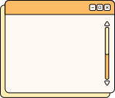
Proposed Solution
Tailor is a custom email generation platform that uses NLP and AI-driven automation to create and send highly personalized emails based on individual recipient profiles. By automating email creation with unique data—like bios and past conversations—Tailor enhances scalability, engagement, and efficiency for organizations such as schools, universities, and businesses, where personalized communication is essential.

Slide 6
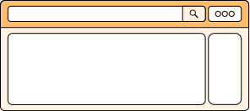

Tailor
Features
NLP-Driven Personalization
Tailor uses advanced NLP algorithms to analyze and incorporate specific details from each recipient’s bio and past interactions, creating contextually relevant and engaging emails.
The AI dynamically customizes each email’s tone, style, and content to align with the individual recipient’s needs, ensuring unique communication.

Slide 7
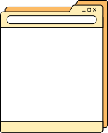
Tailor
Dynamic Task-Based System
Enhanced Engagement and Relevance:
Automated Email Generation and Dispatch
Tailor operates using a task-based architecture where each email customization task is handled by AI agents. These agents adjust content based on recipient-specific data and can operate asynchronously to handle large volumes.
This system allows for modular customization, where each task (e.g., bio inclusion, tone adjustment) is handled individually for optimized personalization.
Through NLP-driven customization and context-sensitive content, Tailor enhances engagement by making emails feel genuinely relevant and personalized to each recipient’s experience and preferences.
This approach drives higher response rates and strengthens organizational relationships with recipients.
Tailor combines personalized email generation with automated dispatch, allowing for seamless integration from content creation to delivery.
This dual functionality enables organizations to automate the entire process, reducing manual effort and ensuring timely, consistent communication.

Slide 8
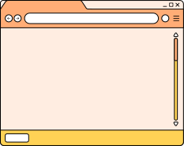

Technology Used
1.Programming Languages and Frameworks:
Python: The primary language for building the backend and task automation scripts.
API Integration: Seamless integration with NLP and AI models through REST APIs.
2.Natural Language Processing (NLP):
OpenAI API: Utilized for content generation, personalization, and tone adjustments.
LangChain: A framework to manage conversations and fine-tune content workflows.
3.Backend Architecture:
Task-Based Architecture: Built to handle modular tasks for personalization (e.g., tone setting, bio referencing).
CrewAI: Used for managing agents and tasks asynchronously.
4.Database and File Handling:
CSV Dataset: Recipient data (e.g., names, emails, bios, and past interactions) stored and processed from CSV files.
File Output: Drafted emails saved as text files or directly sent via email.
5.Email Automation:
Email Libraries: Tools like smtplib or third-party email APIs (e.g., SendGrid) for secure email dispatch.
Automated Workflow: Combines email generation and dispatch for end-to-end automation.
6,Plugins and Libraries:
dotenv: For managing environment variables (e.g., API keys).
timeout-decorator: To handle timeouts for long-running tasks.
pandas: For efficient data manipulation and processing.

Slide 9
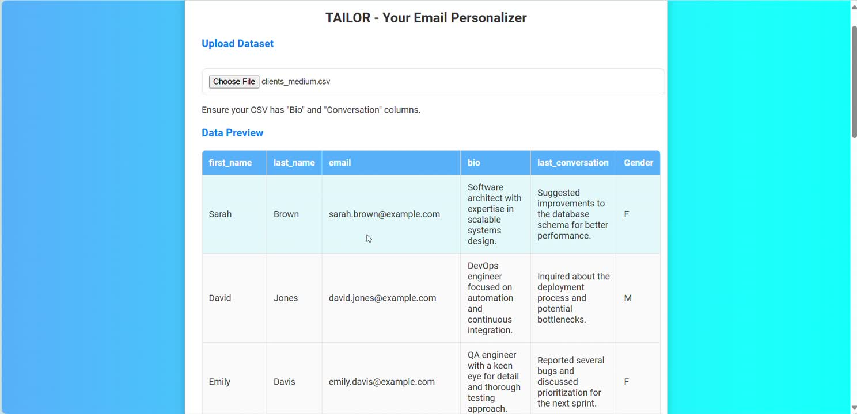
UI/UX
Tailor

Slide 10
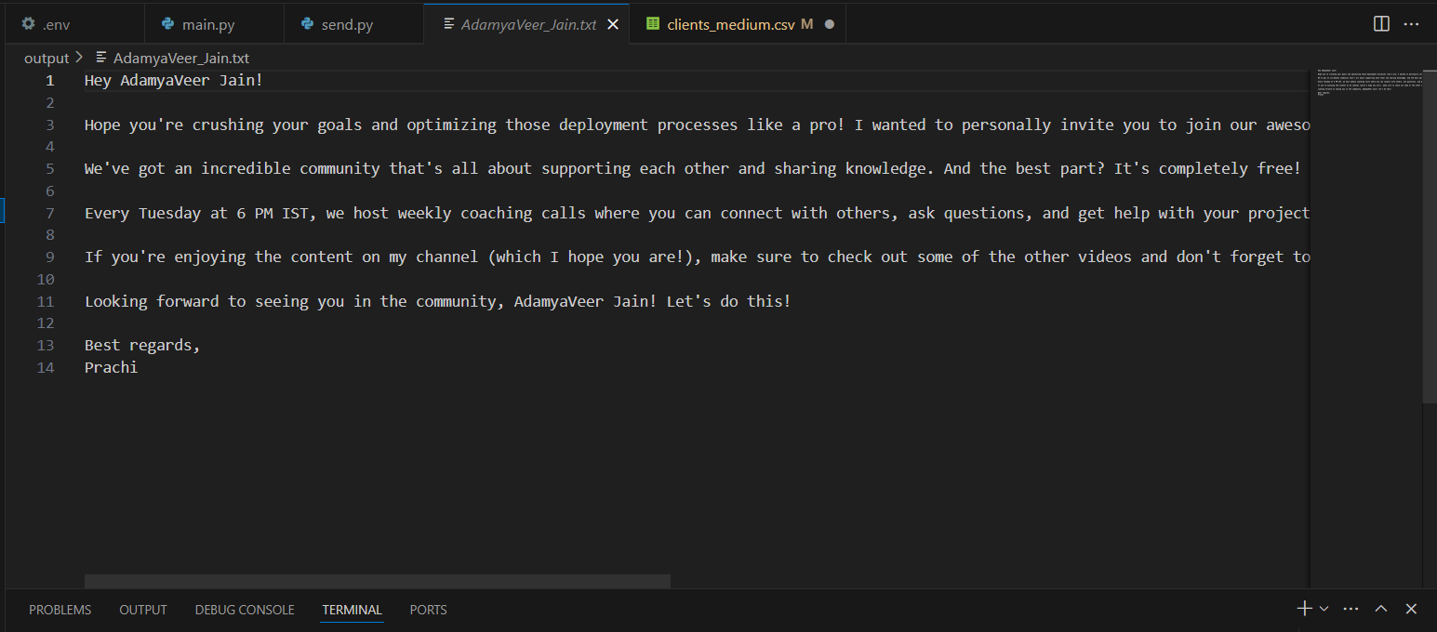
Output
Tailor

Slide 11
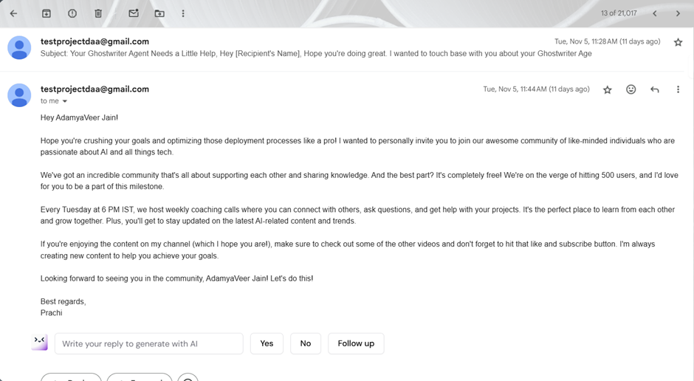
MailBox
Tailor

Slide 12

Future Works & Scope
1.Frontend Integration: Develop a user-friendly interface for dataset upload, real-time email preview, and dispatch control using frameworks like React.js or Vue.js.
2.Multi-Platform Integration: Connect Tailor with Gmail, Outlook, and messaging platforms like WhatsApp and Slack.
3.Analytics & Tracking: Add performance dashboards to track email open rates, clicks, and engagement metrics.
4.Enhanced NLP Features: Expand language support and fine-tune models for industry-specific email personalization.

Slide 13
Tailor
Let’s Move To Code Window
E23CSEU0610
testprojectdaa@gmail.com
www.comingsoon.com

